Slide 1
Project Update
June 10, 2019

Slide 2
Overview
The purpose of this study is to identify transportation solutions to reduce unemployment and improve access to job skills training and employment for the rural workforce in the BCD region.

Slide 3
Key Objectives
Assess the BCD region’s rural workforce & skills
Identify existing & expanding industry training & employment gaps that can be filled by the rural workforce
Create transportation strategies to connect the rural workforce to job skills training & employment to reduce unemployment in rural areas

Slide 4
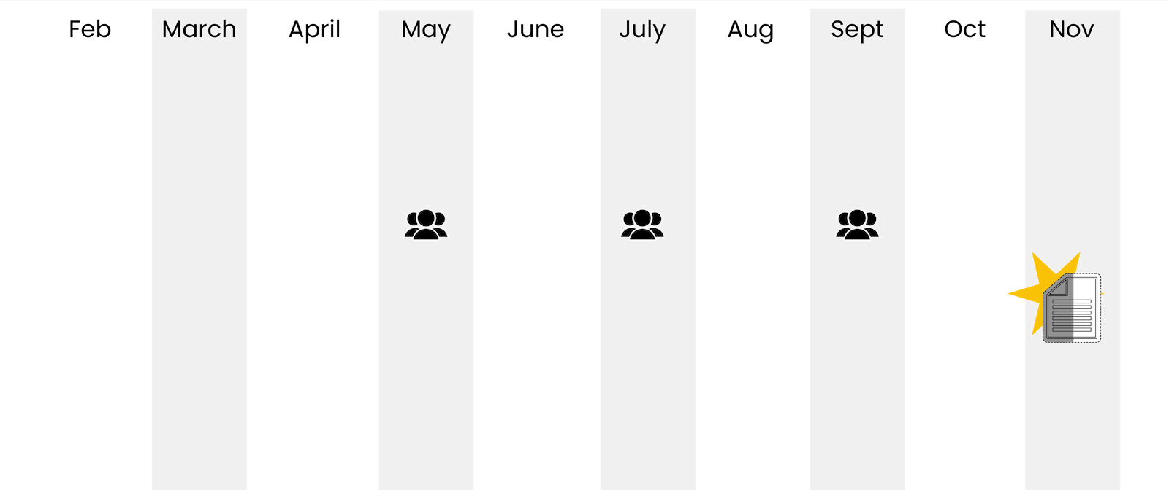
Project Schedule
2019
Task 1: Rural Workforce Needs Assessment
Task 2: Jobs Skills Training & Gap Analysis
Task 3: Transportation Strategies
Stakeholder Meeting May 4
Stakeholder Meeting July 18
Stakeholder Meeting Sept
Final Report

Slide 5
Project Stakeholders
Employers and Chambers
Workforce Agencies
Community Organizations & Churches
Economic Development Organizations
Rural Communities
Higher Education & Training Providers

Slide 6
Transportation Needs Assessment
Key Take-Aways

Slide 7
Findings and Analysis
3 major areas in the rural area with both concentrated populations and limited transportation options
Area 1
Pinopolis, Bonneau, Bonneau Beach, Russellville, St. Stephen
Area 2
Harleyville, Ridgeville, Reevesville, St. George
Area 3
Hollywood, Meggett, Ravenel
Additional Municipalities:
Awendaw, Jamestown, McClellanville
1
2
3

Slide 8
Regional Employment and the Future

Slide 9
Key Regional Employers – BCD Region
Public Sector |  | Private Sector
Company | Employees | Company | Employees
Joint Base Charleston | 20,000 | The Boeing Company | 7,400
Medical University of South Carolina (MUSC) | 13,000 | Roper St. Francis Healthcare | 5,500
Charleston County School District | 6,000 | Trident Health System | 2,500
Berkeley County School District | 6,000 | Walmart, Inc. | 2,300
Dorchester County School District II | 3,500 | Robert Bosch LLC | 1,800
Note: While hospitality sector jobs account for a large percentage of jobs in the region, many employers make up this sector

Slide 10
Five-Year Growth in Job Skills Market
Largest growth in jobs:
Production and Mechanical
Hospitality
Medical
Business Operations Support
Software & IT
66% of the job growth is forecasted to take place in these five industries
Source: 2018 Talent Demand Study

Slide 11
Job & Training Opportunities and Needs
Employment opportunities and training centers:
Primarily Concentrated in the Urban Area
Downtown Charleston & North Charleston
75%+ of employment:
Health Services and Private Education
Leisure and Hospitality
Professional and Business Services
Government and Trade
Transportation and Utilities sectors
Forecasted growth:
Production & Mechanical
Hospitality
Medical
Business Operations Support
Software & IT
Leisure & Hospitality:
Large sector comprised of many employers
Potential sector to focus job training efforts due to the forecasted growth and current strength

Slide 12
Defining Workforce Mobility and Employment Needs

Slide 13
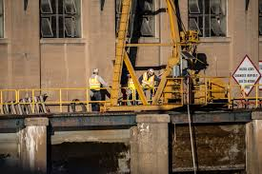
Defining Workforce Mobility
Access to Transportation
Income Levels
Employment Rates
Educational Attainment

Slide 14
Rural Economic Profile Findings
North of Lake Moultrie – highest rates of lack of access to vehicles, low median household incomes
MHI ranges from $32k-37k
In some places, 9% of households lack access to a vehicle
Reevesville – lowest % of high school graduates (75%)
12% of people have a bachelor’s degree
Russellville – lowest % people with a bachelor’s degree (7.9%)
Highest unemployment rate is 19.1% (near Russellville)
North of Ridgeville - unemployment rates of 11.1%
Meggett, Hollywood & Ravenel – lowest unemployment rates

Slide 15
Stakeholder Meeting #1 Recap

Slide 16
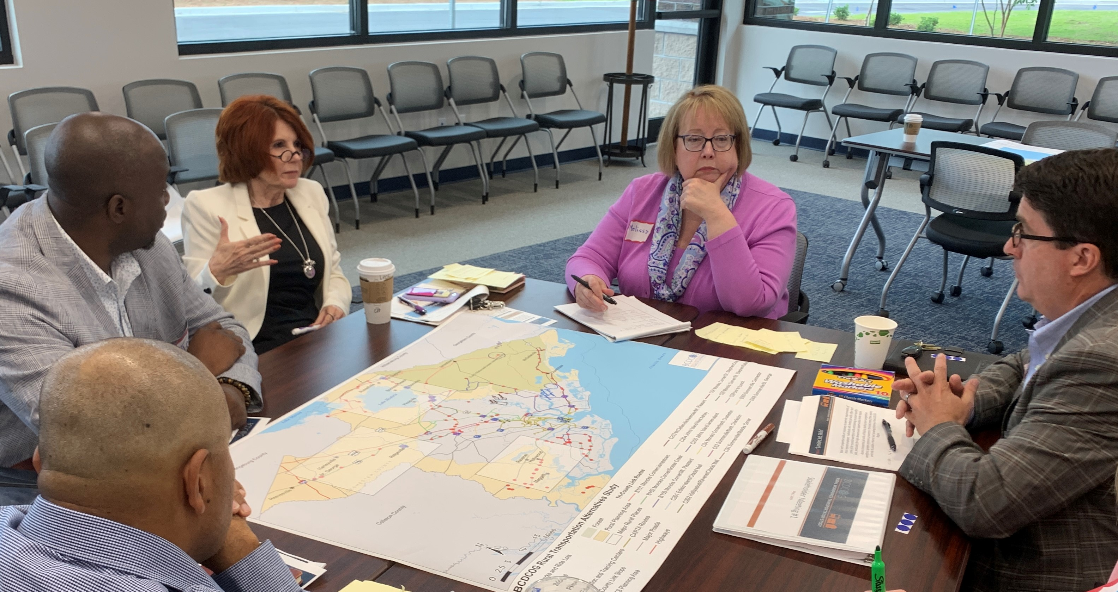
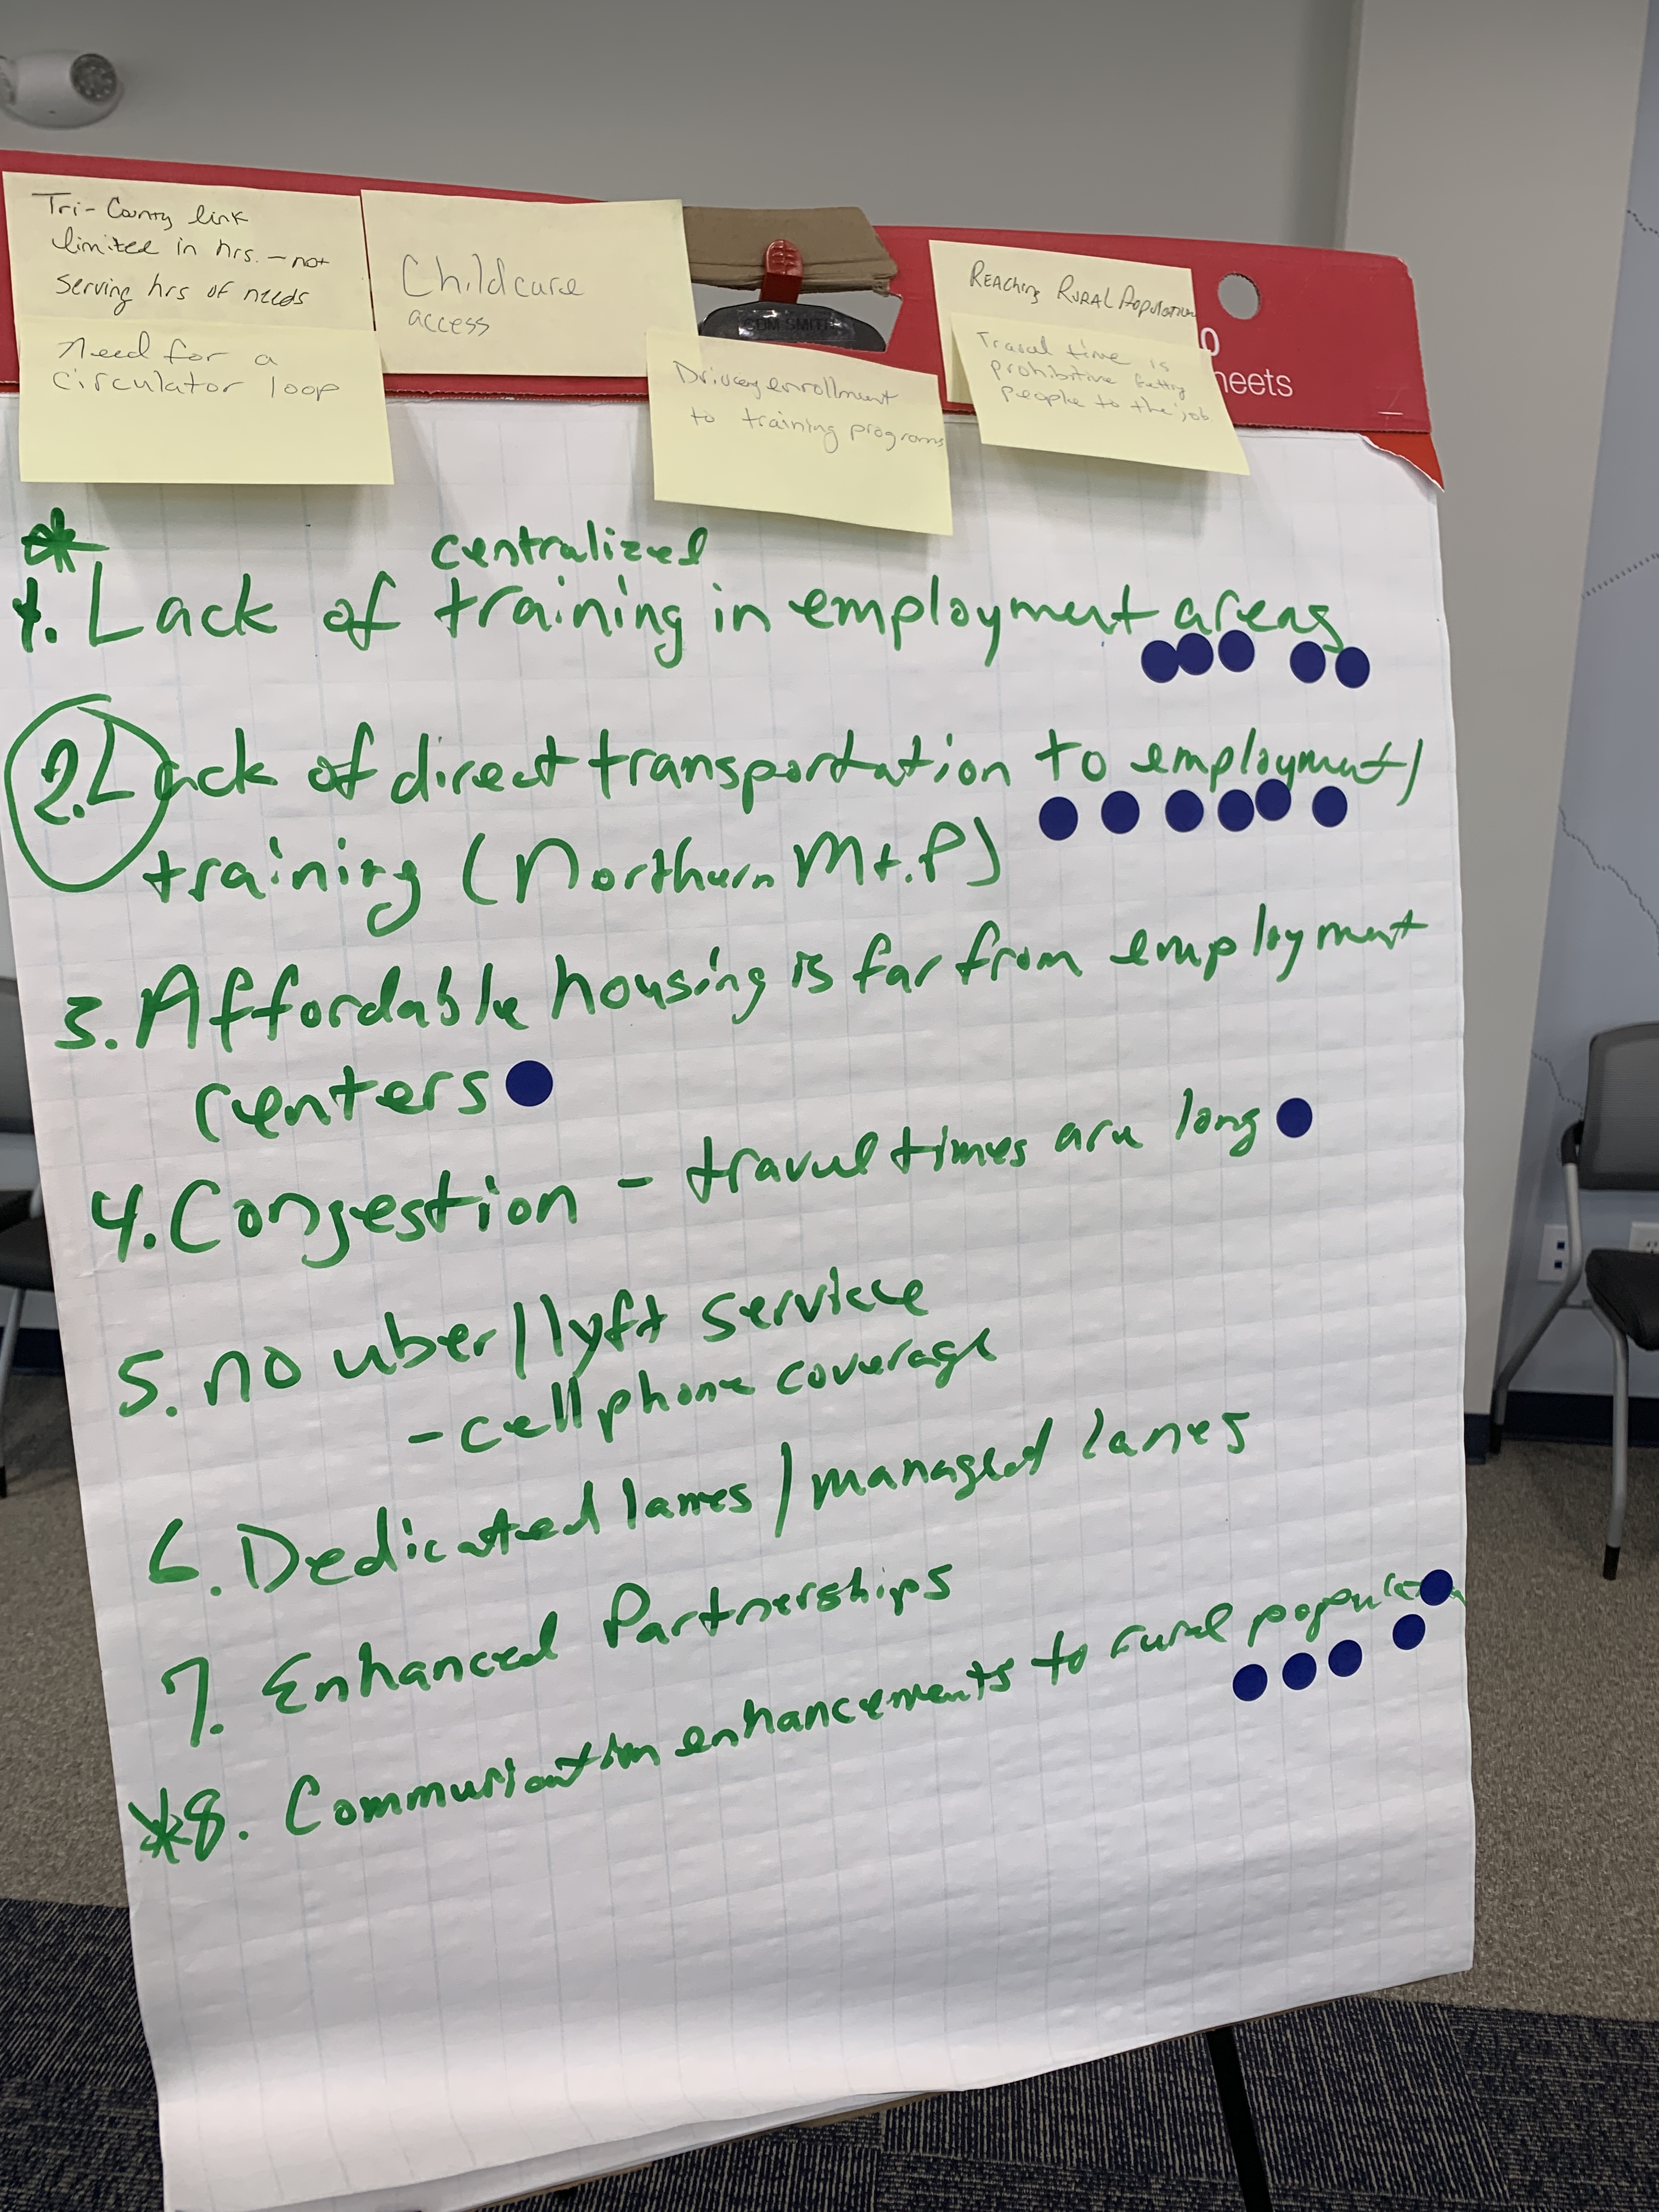
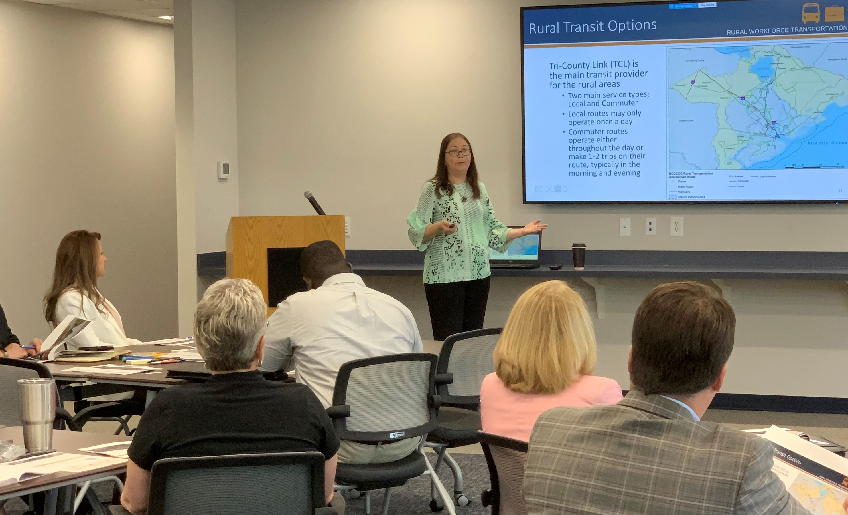
Stakeholder Meeting #1
May 4, 2019

Slide 17
Stakeholder Meeting #1 Recap
Defining “Workforce Mobility”
Workforce mobility not only refers to providing adequate transportation alternatives to connect individuals with opportunities to bridge the skills gap and secure in demand jobs, but it also refers to providing individuals the choice to move across grades and positions within a trade or make a complete change in occupation.

Slide 18
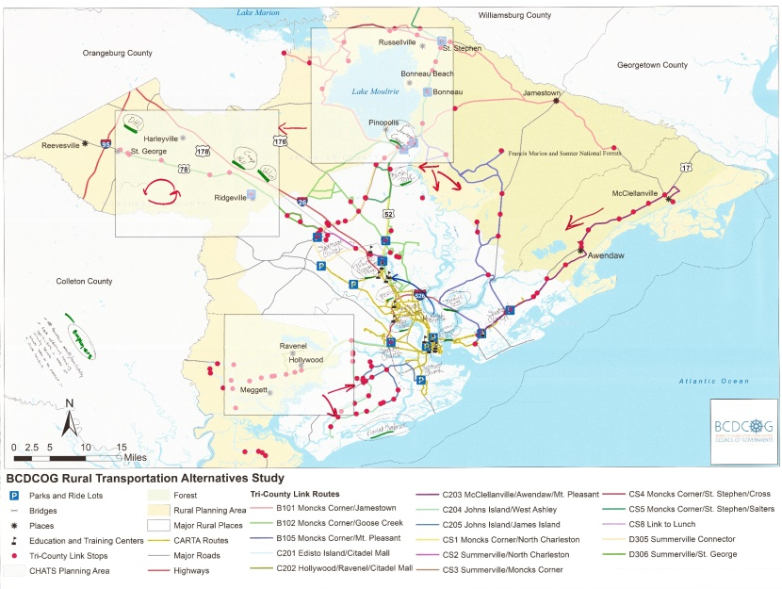
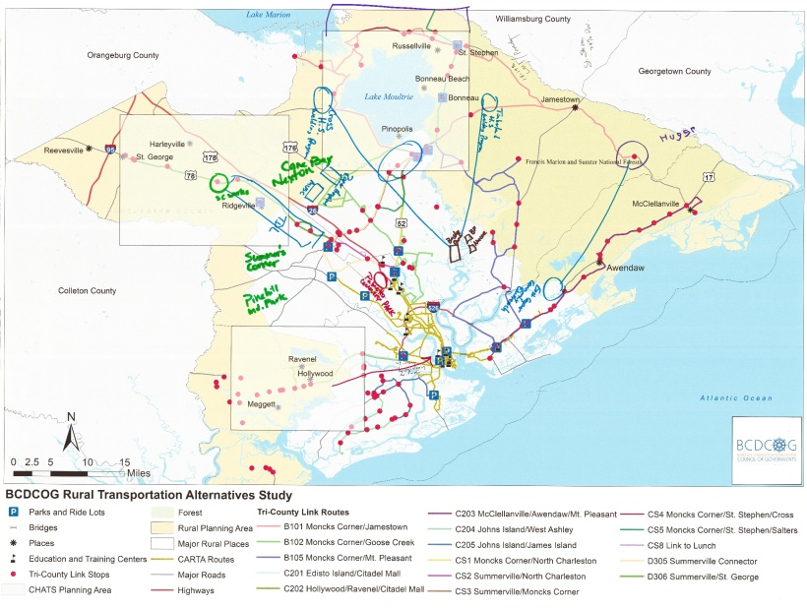
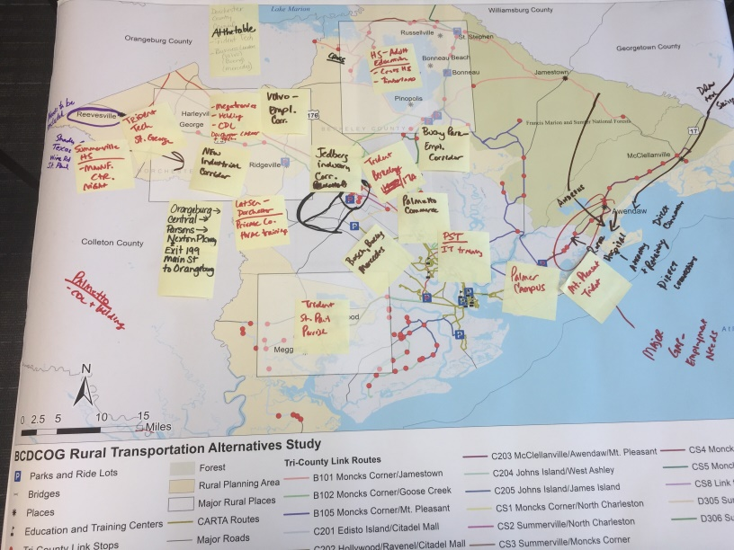
Stakeholder Meeting #1 Recap
Defining “Corridors and Nodes” for further review

Slide 19
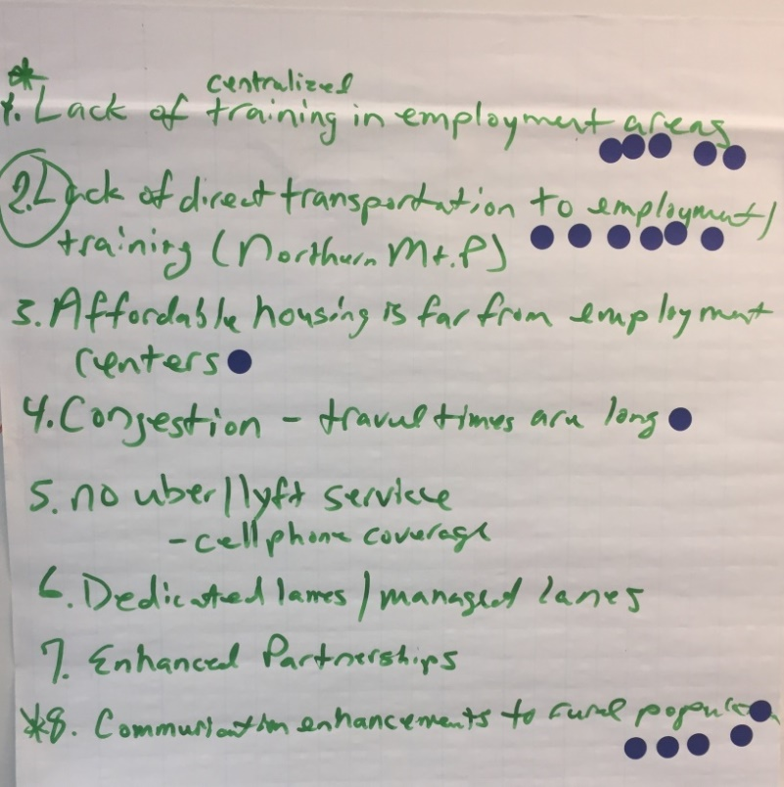
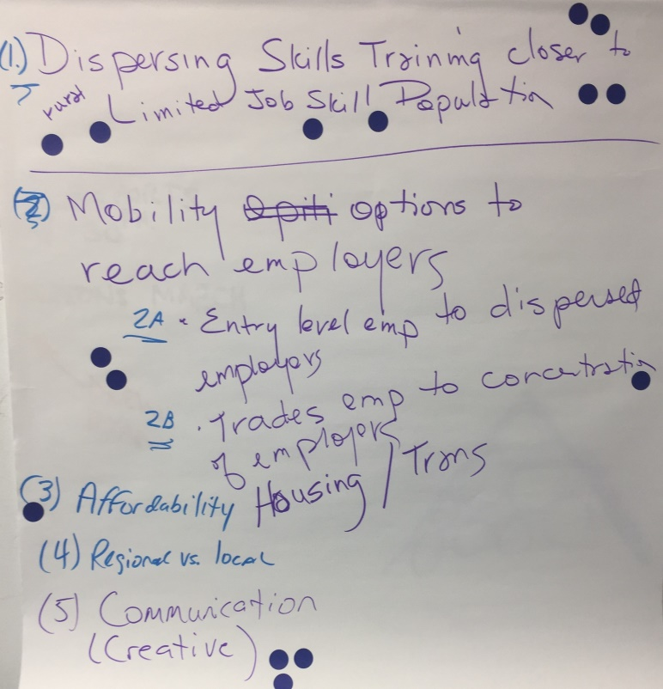
Stakeholder Meeting #1 Recap
Defining primary “Needs and Barriers” for alternatives development
-Connectivity - Transportation & Land Use
-Accessibility - Training Center Locations
-Mobility - Lack of Options
-Communications– Limited Data & Cellular Access

Slide 20
Next Steps

Slide 21
Stakeholder Meeting #2
Scheduled: July 18, 2019
Analyze survey results
Identify alternatives, look at nodes/corridors
Draft evaluation of options and measures of effectiveness

Slide 22
Study Team Contact Information
Sharon Hollis
Berkeley-Charleston-Dorchester Council of Governments
5790 Casper Padgett Way, North Charleston, SC 29406
sharonh@bcdcog.com
Phone: 843.529.0400
Amy L. Livingston
CDM Smith
421 Wando Park Boulevard, Suite 210, Mount Pleasant, SC 29464
LivingstonAL@cdmsmith.com
Phone: 843.972.4553

